Slide 1
CVI 2-D Image Assessment
Roman-Lantzy, C. (2019). Cortical Visual Impairment: Advanced Principles. New York: APH Press
AAC/CVI Summer Institute. (2022). The Bridge School.

Slide 2
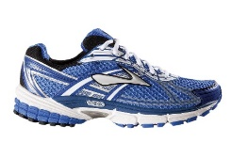

Slide 3
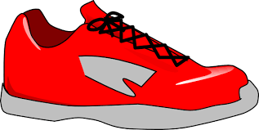

Slide 5
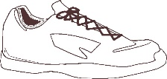

Slide 6
